Slide 1
Mobile Bike
Création d’un site internet pour une entreprise fictive de vente de vélomobiles
Présentation pour la soutenance du 03/09/2026 TIERTANT Alice – 2025D03

Slide 2
Sommaire
1
Présentation
6
Démonstration
2
Langages utilisés
7
Présentation de code
3
Rétroplanning
8
Problèmes rencontrés
4
Wireframe
9
Améliorations à prévoir
Modélisation de la base de donnée
5
10
Conclusion et remerciements

Slide 3
1.
PRÉSENTATION
Qui suis-je et quel est mon projet ?

Slide 4
Bienvenue!
Je suis Alice TIERTANT
Apprentie développeur web

Slide 5
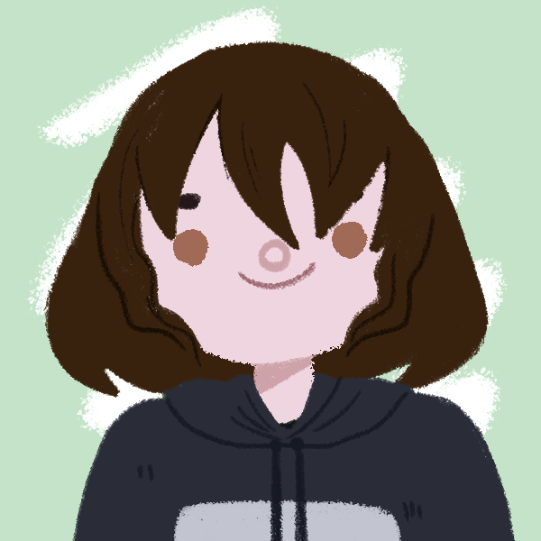
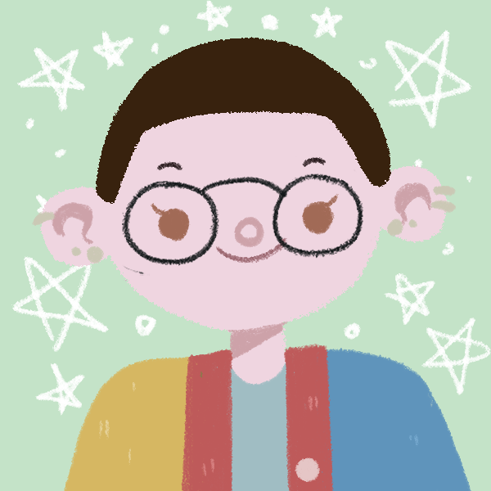


Présentation de l’équipe
RAFFAITIN Romain APPRENTI DEV
Blue is the colour of the clear sky and the deep sea
SEGERS Alcess APPRENTIE DEV
Blue is the colour of the clear sky and the deep sea
TA TRUNG Thang APPRENTI DEV
Blue is the colour of the clear sky and the deep sea
TIERTANT Alice APPRENTIE DEV
Blue is the colour of the clear sky and the deep sea

Slide 6
Timeline
Planification
Développement site vitrine
2025
JAN
FEB
MAR
APR
MAY
JUN
JUL
AUG
SEP
OCT
NOV
DEC
Conception
Test site vitrine
Livraison site vitrine
Test e-commerce
2026
JAN
FEB
MAR
APR
MAY
JUN
JUL
AUG
SEP
OCT
NOV
DEC
Développement e‑commerce
Livraison e‑commerce

Slide 7
Timeline
07 - 08 : Planification 09 – 11 : Conception
04 : Développement front
22 : Congé pathologie grossesse + congé maternité
2025
JAN
FEB
MAR
APR
MAY
JUN
JUL
AUG
SEP
OCT
NOV
DEC
14 – 20 : Développement back
03 : Entrée en entreprise – mise en pause du projet
24 : Fin congé maternité
Reprise développement
Déploiement du site
2026
JAN
FEB
MAR
APR
MAY
JUN
JUL
AUG
SEP
OCT
NOV
DEC
Nouveau maquettage
Reprise cahier des charges
03 – 04 : Présentation projet

Slide 8
Gantt chart
 | 2025 |  |  |  |  |  |  |  |  |  | 2026
 | Mars | Avril | Mai | Juin | Juil | Aoüt | Sept | Oct | Nov | Dec | Jan | Fev | Mars | Avril | Mai | Juin | Juil | Août | Sept
RAFFAITIN Romain
SEGERS Alcess
TA TRUNG Thang
TIERTANT Alice
Légende |  | Présent |  |  |  |  |  | Présent mais ne travaille pas ou peu sur le projet |  |  |  |  |  | Absent du projet

Slide 9
Quotations are commonly printed as a means of inspiration and to invoke philosophical thoughts from the reader.

Slide 10
This is a slide title
Here you have a list of items
And some text
But remember not to overload your slides with content
Your audience will listen to you or read the content, but won’t do both.

Slide 11
Big concept
Bring the attention of your audience over a key concept using icons or illustrations

Slide 12
You can also split your content
White
Is the color of milk and fresh snow, the color produced by the combination of all the colors of the visible spectrum.
Black
Is the color of ebony and of outer space. It has been the symbolic color of elegance, solemnity and authority.

Slide 13
In two or three columns
Yellow
Is the color of gold, butter and ripe lemons. In the spectrum of visible light, yellow is found between green and orange.
Blue
Is the colour of the clear sky and the deep sea. It is located between violet and green on the optical spectrum.
Red
Is the color of blood, and because of this it has historically been associated with sacrifice, danger and courage.

Slide 14
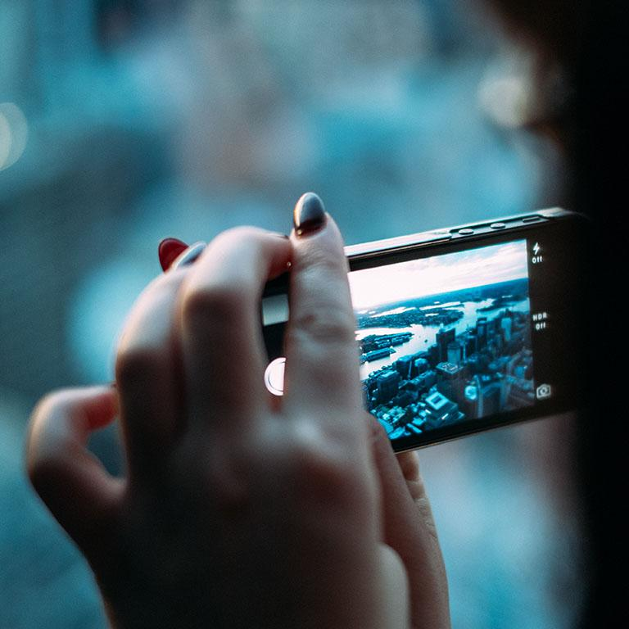
A picture is worth a thousand words
A complex idea can be conveyed with just a single still image, namely making it possible to absorb large amounts of data quickly.

Slide 15
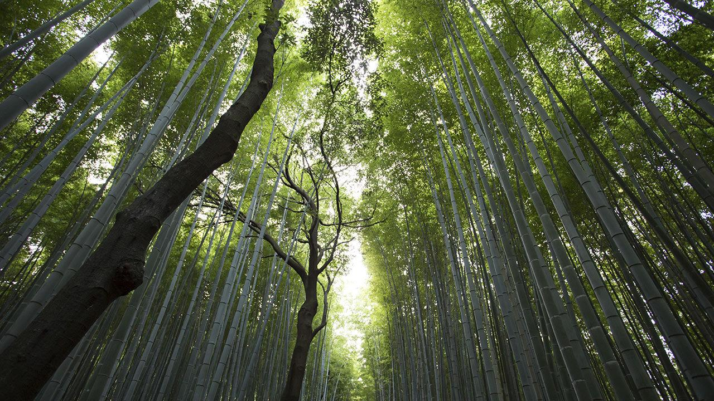
Want big impact? Use big image.

Slide 16
Use charts to explain your ideas
Gray
White
Black

Slide 17
And tables to compare data
 | A | B | C
Yellow | 10 | 20 | 7
Blue | 30 | 15 | 10
Orange | 5 | 24 | 16

Slide 18
Maps
our office

Slide 19
89,526,124
Whoa! That’s a big number, aren’t you proud?

Slide 20
89,526,124$
185,244 users
100%
That’s a lot of money
And a lot of users
Total success!

Slide 21
Our process is easy
first
second
last

Slide 22
Let’s review some concepts
Yellow
Is the color of gold, butter and ripe lemons. In the spectrum of visible light, yellow is found between green and orange.
Blue
Is the colour of the clear sky and the deep sea. It is located between violet and green on the optical spectrum.
Red
Is the color of blood, and because of this it has historically been associated with sacrifice, danger and courage.
Yellow
Is the color of gold, butter and ripe lemons. In the spectrum of visible light, yellow is found between green and orange.
Blue
Is the colour of the clear sky and the deep sea. It is located between violet and green on the optical spectrum.
Red
Is the color of blood, and because of this it has historically been associated with sacrifice, danger and courage.

Slide 23
4000
3000
2000
1000
0
You can insert graphs from Excel or Google Sheets

Slide 24
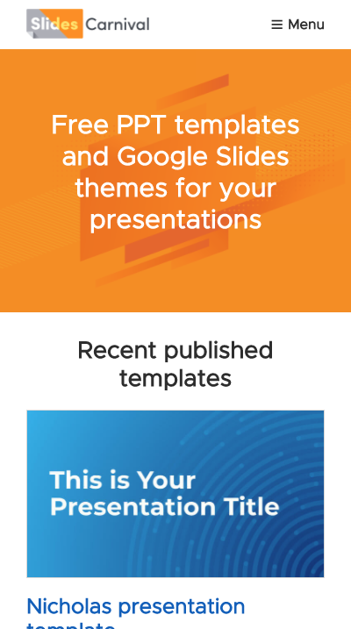
Mobile project
Show and explain your web, app or software projects using these gadget templates.

Slide 25
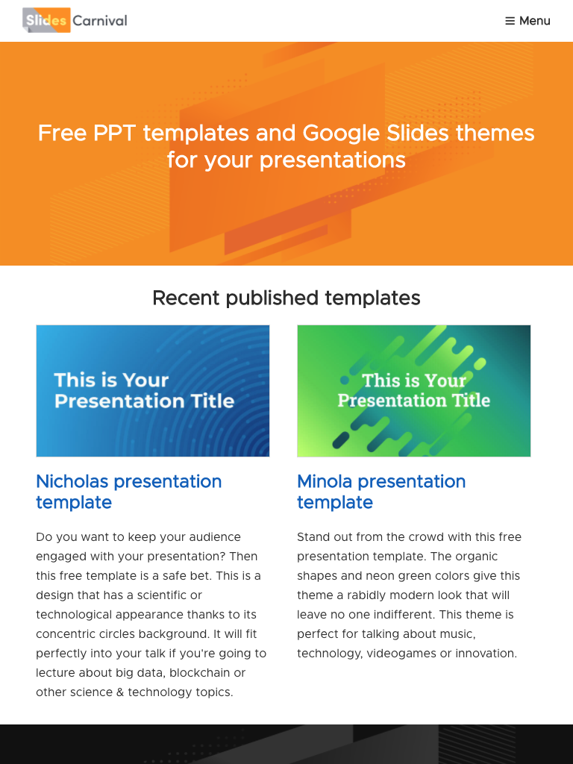
Tablet project
Show and explain your web, app or software projects using these gadget templates.

Slide 26
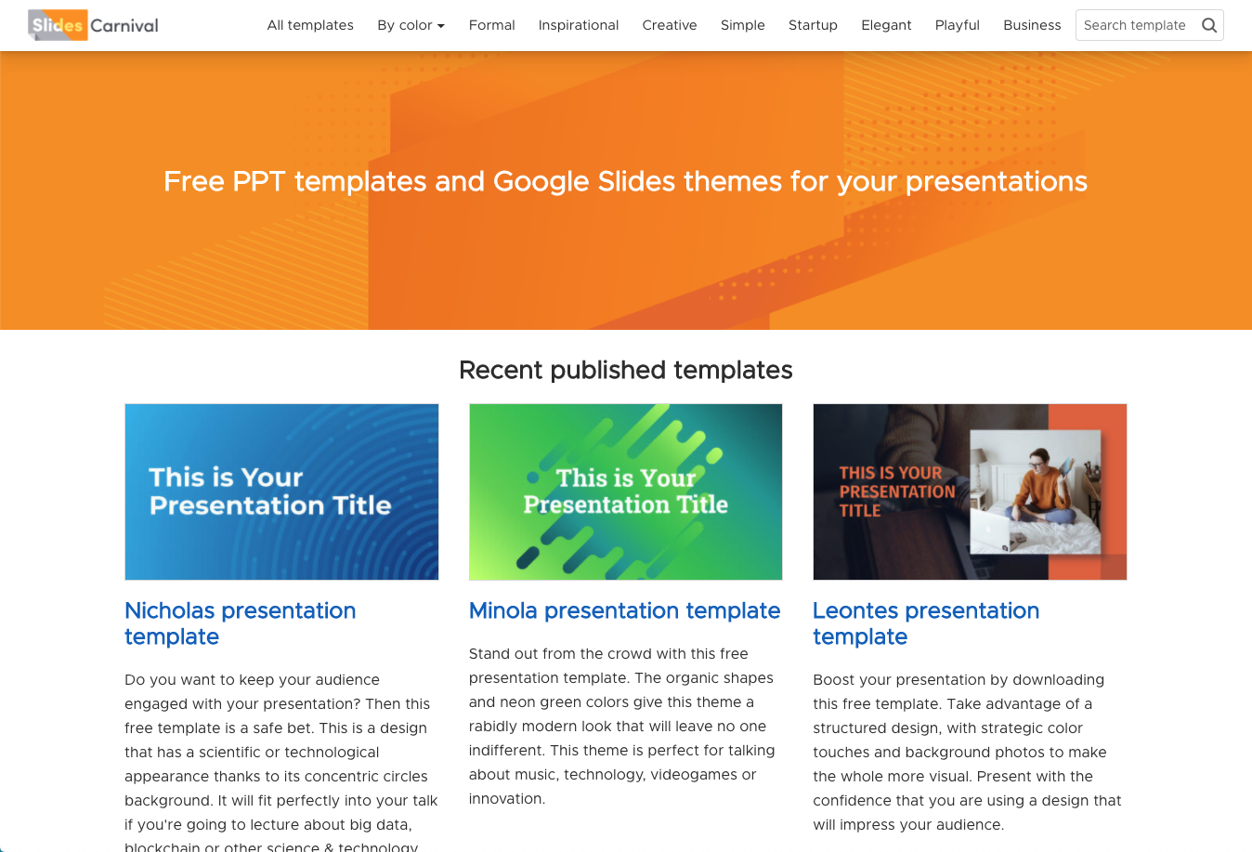
Desktop project
Show and explain your web, app or software projects using these gadget templates.

Slide 27
Thanks!
Any questions?
You can find me at @username & user@mail.me

Slide 28
Credits
Special thanks to all the people who made and released these awesome resources for free:
Presentation template by SlidesCarnival
Photographs by Unsplash

Slide 29
Presentation design
This presentation uses the following typographies and colors:
Titles: Raleway
Body copy: Karla
You can download the fonts on these pages:
https://www.fontsquirrel.com/fonts/raleway
https://www.fontsquirrel.com/fonts/karla
Dark green #004c52 / Aqua green #00ae9d / Lime green #abe33f
You don’t need to keep this slide in your presentation. It’s only here to serve you as a design guide if you need to create new slides or download the fonts to edit the presentation in PowerPoint®

Slide 30
2. Extra Resources
For Business Plans, Marketing Plans, Project Proposals, Lessons, etc

Slide 31
Timeline
Blue is the colour of the clear sky and the deep sea
Red is the colour of danger and courage
Black is the color of ebony and of outer space
Yellow is the color of gold, butter and ripe lemons
White is the color of milk and fresh snow
Blue is the colour of the clear sky and the deep sea
JAN
FEB
MAR
APR
MAY
JUN
JUL
AUG
SEP
OCT
NOV
DEC
Yellow is the color of gold, butter and ripe lemons
White is the color of milk and fresh snow
Blue is the colour of the clear sky and the deep sea
Red is the colour of danger and courage
Black is the color of ebony and of outer space
Yellow is the color of gold, butter and ripe lemons

Slide 32
Roadmap
Blue is the colour of the clear sky and the deep sea
Red is the colour of danger and courage
Black is the color of ebony and of outer space
1
3
5
2
4
6
Yellow is the color of gold, butter and ripe lemons
White is the color of milk and fresh snow
Blue is the colour of the clear sky and the deep sea

Slide 33
Timeline
Red is the
Black is the color
Yellow is the colo
White is t
Blue is the colour of
2025
JAN
FEB
MAR
APR
MAY
JUN
JUL
AUG
SEP
OCT
NOV
DEC
White is
Blue is
Red is the colour
Black is the c
Yellow is the c
Blue is
Red is the
Black is the color
Yellow is the colo
White is t
2026
JAN
FEB
MAR
APR
MAY
JUN
JUL
AUG
SEP
OCT
NOV
DEC
Yellow
White is
Blue is
Red is the colour

Slide 34
SWOT Analysis
STRENGTHS
Blue is the colour of the clear sky and the deep sea
WEAKNESSES
Yellow is the color of gold, butter and ripe lemons
S
W
Black is the color of ebony and of outer space
OPPORTUNITIES
White is the color of milk and fresh snow
THREATS
O
T

Slide 35
Business Model Canvas
Key Partners
Insert your content
Key Activities
Insert your content
Value Propositions
Insert your content
Customer Relationships
Insert your content
Customer Segments
Insert your content
Key Resources
Insert your content
Channels
Insert your content
Cost Structure
Insert your content
Revenue Streams
Insert your content

Slide 36
Funnel
AWARENESS
Insert your content
DISCOVERY
Insert your content
EVALUATION
Insert your content
INTENT
Insert your content
PURCHASE
Insert your content
LOYALTY
Insert your content

Slide 37
Competitor Matrix
HIGH VALUE 2
Competitor
Our company
Competitor
Competitor
LOW VALUE 1
HIGH VALUE 1
Competitor
Competitor
Competitor
LOW VALUE 2

Slide 38
Weekly Planner
 | SUNDAY | MONDAY | TUESDAY | WEDNESDAY | THURSDAY | FRIDAY | SATURDAY
09:00 - 09:45 | Task | Task | Task | Task | Task | Task | Task
10:00 - 10:45 | Task | Task | Task | Task | Task | Task | Task
11:00 - 11:45 | Task | Task | Task | Task | Task | Task | Task
12:00 - 13:15 | ✔ Free time | ✔ Free time | ✔ Free time | ✔ Free time | ✔ Free time | ✔ Free time | ✔ Free time
13:30 - 14:15 | Task | Task | Task | Task | Task | Task | Task
14:30 - 15:15 | Task | Task | Task | Task | Task | Task | Task
15:30 - 16:15 | Task | Task | Task | Task | Task | Task | Task

Slide 39
SlidesCarnival icons are editable shapes.
This means that you can:
Resize them without losing quality.
Change fill color and opacity.
Change line color, width and style.
Isn’t that nice? :)
Examples:

Slide 40
Diagrams and infographics

Slide 41
You can also use any emoji as an icon!
And of course it resizes without losing quality.
How? Follow Google instructions https://twitter.com/googledocs/status/730087240156643328
✋👆👉👍👤👦👧👨👩👪💃🏃💑❤😂😉😋😒😭👶😸🐟🍒🍔💣📌📖🔨🎃🎈🎨🏈🏰🌏🔌🔑 and many more...

Slide 42

Free templates for all your presentation needs
For PowerPoint and Google Slides
100% free for personal or commercial use
Ready to use, professional and customizable
Blow your audience away with attractive visuals

